Slide 1

Registered charity no. 1107969

Slide 2
Our Values
A life that grows
Everyone has something to offer
Connections matter
Standing together
Passion
Registered charity no. 1107969

Slide 3
Connecting Parents
An holistic, community-powered advocacy service for parents with a learning disability in Coventry which will help them:
become better parents;
navigate social care’s risk averse approach to giving them the chance ; and
build stronger connections with their communities.
Registered charity no. 1107969

Slide 4
How have we developed the project?
Motivation for the project has been from our own experience in supporting parents with learning disabilities.
It’s our experience of working closely with parents and professionals and trialling different, ‘beyond’ advocacy ways of helping parents, that forms the foundation and the vision for this project.
Registered charity no. 1107969

Slide 5
Who is Connecting Parents for?
Parents
Connecting Parents will reach two types of parents or pregnant women with learning disabilities:
those whose severity of learning disability prevents them from becoming competent parents; and
those who have a less severe learning disability but have an educational, environmental or social deficit that affects their ability to parent and increases their likelihood of becoming stuck in a cycle of repeated pregnancies and adoptions
Parents will be experiencing one or more of the following:
pregnancy;
involvement in childcare/court proceedings; and
rebuilding their life after adoption of a child
Registered charity no. 1107969

Slide 6
Volunteers
Connecting Parents will be delivered through a network of volunteer advocates, parents who will be trained to speak up for parents, teach them parenting skills and help them build connections to their community and other parents.
They will be fully supported by Grapevine and, in particular, our professional advocacy service will still be on hand to help meet their need for professional representation in child care proceedings.
Registered charity no. 1107969

Slide 7
Outcomes for Parents
More positive relationships with people in their community
Better parenting skills
Ability to make more positive choices about relationships and becoming pregnant (averting the cycle of unplanned pregnancy and adoption)
Greater resilience to negative experiences of parenthood
Increased self esteem, improved self-care and life skills, and a greater ability to speak up for themselves, challenge and speak more knowledgably for and about their children
Reduced likelihood of childcare proceedings and the number of adoptions for target group
Registered charity no. 1107969

Slide 8
Outcomes for professional practice
More effective communication and understanding between professionals and parents
Increased awareness of isolation experienced by parents with learning disabilities leading increased understanding of how to reduce parental isolation and increase resilience
Reduced crisis workloads and better understanding of parents’ needs at times of crisis
Improved flow of communication and reporting between professionals
Registered charity no. 1107969

Slide 9
One to one support
Volunteer advocates will provide long term, regular face-to-face support to pregnant mothers and parents with learning disabilities in the following ways:
Provision of long term listening, non-judgemental support so that parents have space to explore issues and develop their approach to being a parent.
Moral support and help to manage professional visits from midwives, health visitors and social workers etc, helping them to understand what professionals are telling them and how to ask questions.
Teaching parenting skillsthrough role modelling effective parenting and sharing their own experience.
Teaching self-care skills
Help to build community connections and be socially active.
Childcare proceedings and post-adoption support
Registered charity no. 1107969

Slide 10
Monthly support groups
Every month we will bring parents and volunteers together to get peer support, take part in workshops, and engage with professionals in a different setting. The meeting format will be flexible but each one is likely to include space for:
Skill sharing e.g healthy living, cooking
Workshops e.g. hygiene skills, keeping safe in relationships
Training and learning opportunities for volunteers
Professional speakers
Parenting surgeries where volunteers and parents can ask questions
Peer support, socialising and making new connections (for everyone)
Registered charity no. 1107969

Slide 11
After the project
A Self-Sufficient Support Framework
Sustainable and self-sufficient relationships between volunteers and parents continuing after the project ends
A new self-governing group to continue running monthly meetings for parents and volunteers
An informal network of parents and volunteers to allow them to share their experiences and help others.
Registered charity no. 1107969

Slide 12
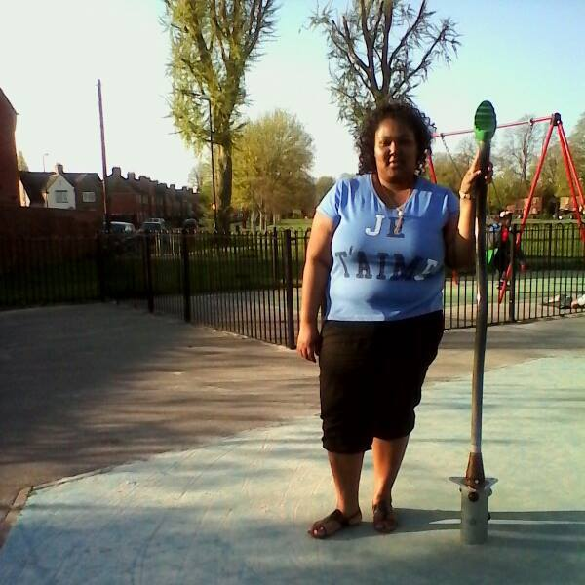
Sarah’s Story
Registered charity no. 1107969

Slide 13
www.grapevinecovandwarks.org
From all of us, thank you
Grapevine Cov and Warks
@GrapevineCov @Grapevine YP @ Grapevine FR
Grapevine Cov and Warks
Registered charity no. 1107969

